Slide 1

BS”D
Whole Life vs.
Universal Life
Selecting the Right Structure for Estate Funding
David Kakon, Math Honours B.Sc.
Armstrong Financial Services
March 2026

Slide 2


Executive Summary
The Objective
The Choice
For corporate owners, the primary role of permanent insurance is to fund a defined future tax liability with tax-free liquidity at the precise moment it is crystallized.
When the goal is a specific liability amount, the choice between Participating Whole Life and Universal Life is not about "better" or "worse" products, but rather a structural decision about efficiency, risk, and capital allocation.

Slide 3









Participating Whole Life: The Mechanics
Fixed Base
Dividend Growth
The "Yield" Myth
Built around a fixed premium and a base death benefit. Any value beyond this relies entirely on non-guaranteed performance.
Dividends are used to purchase Paid-Up Additions (PUA). The death benefit growth is dependent on the insurer's dividend scale.
The Dividend Scale Interest Rate (DSIR) is not the policy yield. It is just one component in a complex formula blending mortality, expenses, and taxes.

Slide 4
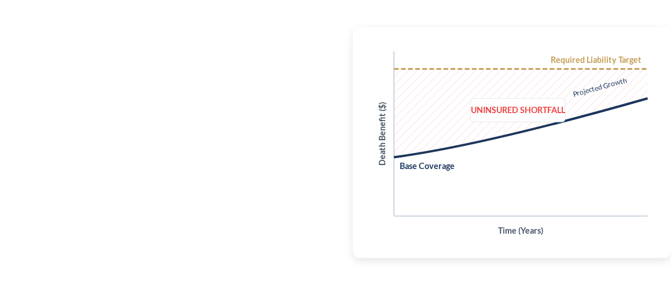
Paid Up Dividends: The Structural Trade-off
Because Whole Life relies on growth to hit targets, matching a fixed liability forces a difficult choice:
•
Option A: Shortfall Risk. Set base coverage below the liability and hope dividends catch up. This leaves the estate under-insured for decades.
•
Option B: Excess Cost. Buy the full liability upfront. The policy continues to grow, forcing you to pay for "excess" coverage you don't need, diverting capital from your business.

Slide 5


Level Universal Life
Designed for Precision
Level Universal Life is structurally designed to match a fixed estate liability with a contractually fixed death benefit from inception.
Efficiency Over Growth
Unlike Whole Life, which uses returns to increase coverage, Level UL applies tax-free growth internally to reduce future insurance costs. This minimizes the corporate capital required to maintain the policy.

Slide 6









Funding Solution: Sun Life Diversified Account
We resolve the "GIC vs. Equity" dilemma using Institutional Smoothed-Yield Accounts.
Capital Protection
Stability
Institutional Access
Features a 0% floor, guaranteeing that the credited rate will never be negative, protecting your downside.
Typically illustrates between 3.5% and 4.1%, trading with near-zero volatility (SD ~0.8%) for predictable planning.
Access the same asset pool as Whole Life: Private fixed income, commercial mortgages, bonds and real estate.

Slide 7

Corporate Reality: Net-to-Estate
CDA Mechanics
Share Valuation (CSV)
The Capital Dividend Account (CDA) credit is generally the Death Benefit minus the Adjusted Cost Basis (ACB). A higher ACB (common in Whole Life) means less of the benefit is tax-free.
On death, the policy's Cash Surrender Value (CSV) increases the value of corporate shares. This can trigger additional capital gains tax, reducing the net amount the estate actually receives.
True efficiency is measured by what the shareholders keep, not the gross policy value.

Slide 8





Methodology: A Fair Comparison
A meaningful comparison between Whole Life and Universal Life requires a tax-adjusted Net-to-Estate analysis using matched funding.
Benchmark
Establish Cost
Remove Bias
Tax Adjust
Compare
Define the specific required liability.
Solve for the UL premium to fully fund the liability.
Apply that premium to the best-fit Whole Life policy.
Account for CDA and CSV capital gains
Evaluate outcome through lifetime to LE.

Slide 9

Case Study: The Parameters
•
Client: 55-year-old Male, Non-smoker.
•
Owner: CCPC Holding Inc. (Quebec).
•
Objective: $10,000,000 Net-to-Estate Liquidity.
•
Funding: 10-Year Pay Schedule.
•
Timeline: Life Expectancy (Age 85).
•
UL Assumption: 100% SLDA @ 3.95%.
•
WL Assumption: Sun Par Protector @ 5.25% (-1%)

Slide 10
Case Study: Summary of Results
⇒ Net-to-Estate = CDA + [ (FV − CDA) × (1 − 48.70%) ] − [ CSV × 26.65%]
We first solve for a Universal Life design that provides level coverage from inception and for life, intended to precisely deliver the target Net-to-Estate outcome. The required annual premium derived from this becomes the fixed input for the comparison.
The results below reflect after-tax Net-to-Estate outcomes (accounting for CDA credits and taxes), rather than potentially misleading gross values. Both policies have identical premium inputs of ($341,768 × 10).

Slide 11
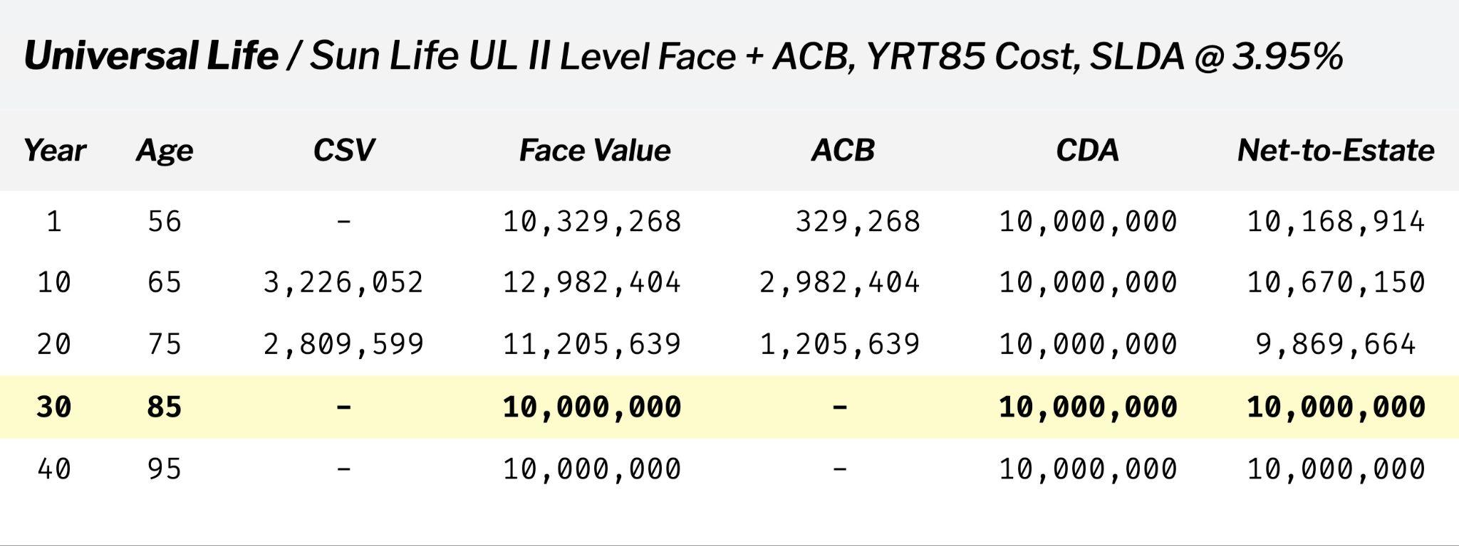
Case Study: Universal Life (Level+ACB)

Slide 12
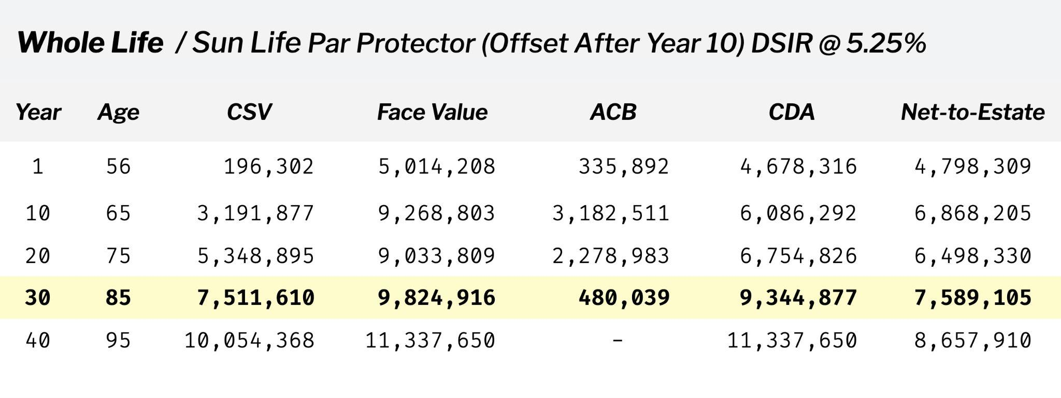
Case Study: Whole Life Par

Slide 13
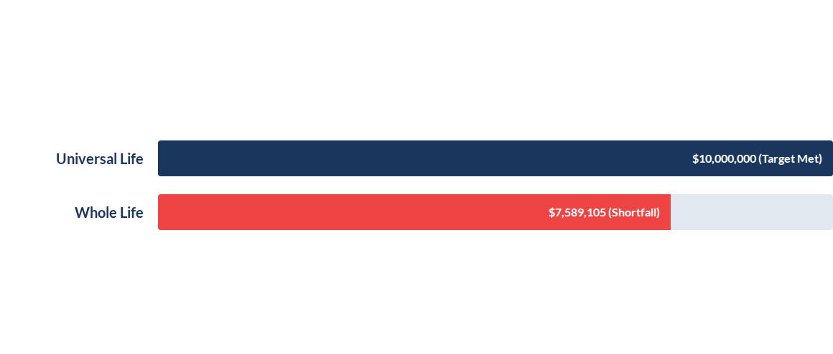
Results: Net-to-Estate at Age 85
With identical funding ($341,768/yr for 10 years), Universal Life meets the target.
Whole Life falls significantly short due to structural inefficiency.
Shortfall: -$2,410,895

Slide 14
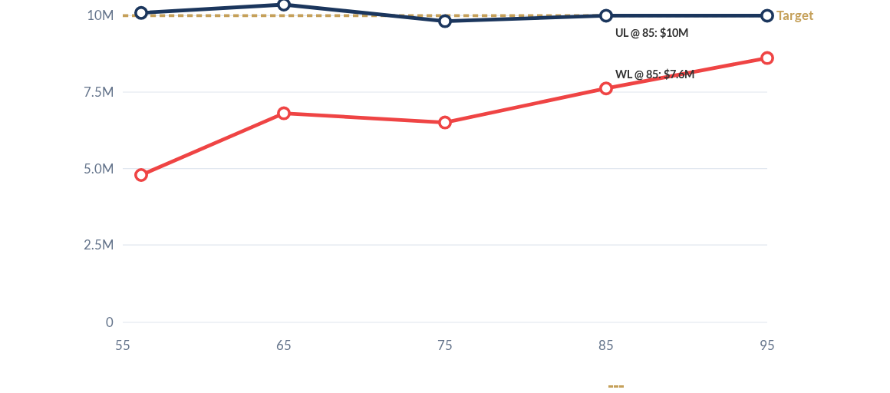
Lifetime Net-to-Estate Analysis
Universal Life @ 3.95%
Whole Life @ 5.25%
$10M Liability Target

Slide 15


Conclusion
Structure Matters
Using identical premiums, Universal Life outperforms Whole Life not only at life expectancy but throughout the entire policy duration.
Universal Life locks in full liability coverage from inception and directs performance to lowering costs.
Whole Life starts with a coverage gap and never catches up, leaving the estate underinsured by over $2.4M at the critical moment.

Slide 16

Questions?
David Kakon, Math Honours B.Sc.
Armstrong Financial Services
David@ArmstrongLife.com | (514) 574-0233

